Slide 1
Reverse Word Drop
Andrew Guandique, James Le, Michael Sanfilippo

Slide 2
Game Concept
An educational game where the objective of the game is to spell a word, such as “Hello”, by removing the letters that don’t belong in it like A,B, C.
To do this the player must eliminate (pop) the WRONG letters before they reach the bottom screen and only let the CORRECT letters fall
The game continues until either the player finishes spelling all the words for that stage or the health bar reaches zero indicating a game over

Slide 3
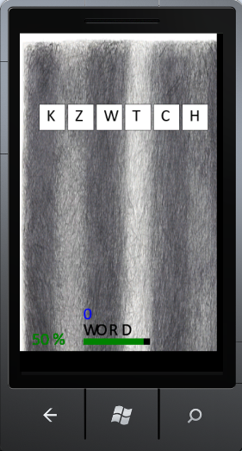
Screen Shots

Slide 4
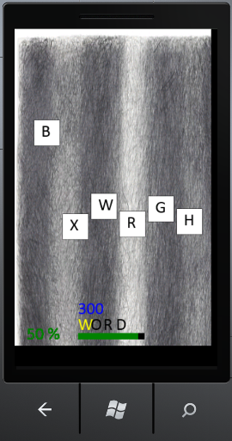
Cont.

Slide 5
Target Audience
Target group: Everyone (ages 5 - 85)
Want players to actually learn the words they are spelling
The challenge of the game is similar to the idea of negative space, challenging players to remember what letters spell a word and to actively avoid those same letters and safely pop the remaining ones
Summing up the game with a metaphor, it’s like teaching a person to use their left hand, they have to use what they know but in a new way, the game forces the player to learn to spell words this new and strange way

Slide 6
Game Features
Different modes
In one mode you must spell the word sequentially which will keep a stronger focus on the ordering of the letters in the word.
In the second mode will give them a greater challenge because you have to retain the word in your mind and the different
Study Mode where you enter your own list of words, which then the player which mode to play

Slide 7
Difficulty settings
Changes the game based on:
The density of letters you see that are in the word
Increase in speed that the letters fall
The health bar system becomes more challenging
The longer the game goes on, the longer the word becomes
Hitting the WRONG letters or letting them hit the bottom incur penalties

Slide 8
Demo

